Slide 1
Lecture 5: 指针

Slide 2

第五讲 指针和基于指针的字符串
学习目标：
指针和引用的异同
指针作为参数传递给函数
基于指针的 C 风格的字符串
指针和数组的关系
函数指针

Slide 3
1 Introduction
指针(Pointers)
功能强大但难于掌握
可以用来执行 pass-by-reference
可以用来创建和操纵动态数据结构
与数组和字符串有着密切的关系

Slide 4
2 Pointer Variable Declarations and Initialization
Pointer variables
将内存地址作为变量值
通常变量包含特定的值 (直接引用)
指针包含变量的地址值 (间接引用)
Indirection
通过指针来引用变量的值
Notes:
Codes translated into machine language by a program called the “assembler”.

Slide 5
2 Pointer Variable Declarations and Initialization
Pointer declarations
* 指示一个变量为指针变量
声明一个int 型变量的指针：int *myPtr;
声明多个指针变量：int *myPtr1, *myPtr2;
Pointer initialization
初始化为 0, NULL 或一个地址
指针初始化的目的是防止它指向内存中非用户数据区，从而引起一系列的错误。

Slide 6
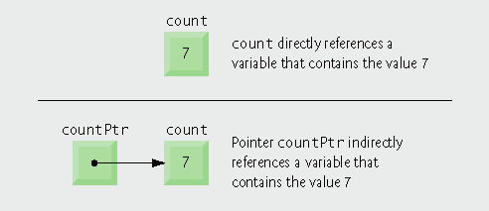
2 Pointer Variable Declarations and Initialization

Slide 7

2 Pointer Variable Declarations and Initialization
常见编程错误：声明指针变量时，没有在指针变量前面加上 “ * ”。
良好编程习惯：在指针变量名中包含字母 Ptr能够更清楚地表示这个变量是指针变量。
错误预防技巧：指针初始化是为了防止指向未知的、未经初始化的甚至是系统使用的内存区域。

Slide 8

3 Pointer Operators
取地址运算符 (&)
返回操作数的地址
int y = 5; int *yPtr; yPtr = &y; //变量 yPtr “指向” y

Slide 9
3 Pointer Operators
取值运算符(*)
也称为 indirection operator or dereferencing operator (间接运算符、间接引用运算符)
*yPtr 返回 y (取指针yptr所指向地址的值)
Dereferenced pointer is an lvalue
*yPtr = 5;
* and & are inverses of each other(互逆操作)

Slide 10

3 Pointer Operators

Slide 11
Outline
Variable aPtr is a point to an int
Initialize aPtr with the address of variable a
int a=7;
int *aptr=a;
int a;
int *aptr=a;
a=7;

Slide 12
Outline
Address of a and the value of aPtr are identical
Value of a and the dereferenced aPtr are identical
* and & are inverses of each other
* and & are inverses; same result when both are applied to aPtr

Slide 13
4 Passing Arguments to Functions by Reference with Pointers
三种向函数传递参数的方式
Pass-by-value(值传递)
Pass-by-reference with reference arguments(以引用为参数的引用传递)
Pass-by-reference with pointer arguments(以指针为参数的引用传递)

Slide 14
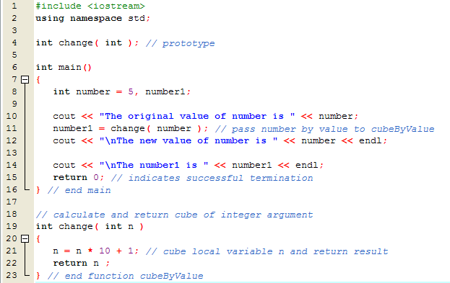
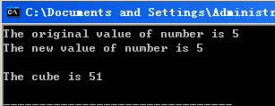
值传递方式
优点：保护实参，不受被调用函数的影响
缺点：被调用函数无法修改实参

Slide 16
Pass number by value; result returned by cubeByValue
cubeByValue receives parameter passed-by-value
Cubes local variable n
and return the result

Slide 17
Outline
Prototype indicates parameter is a pointer to an int
Apply address operator & to pass address of number to cubeByReference
cubeByReference modifies variable number
cubeByReference receives address of an int variable,
i.e., a pointer to an int
Modify and access int variable using indirection operator *

Slide 18
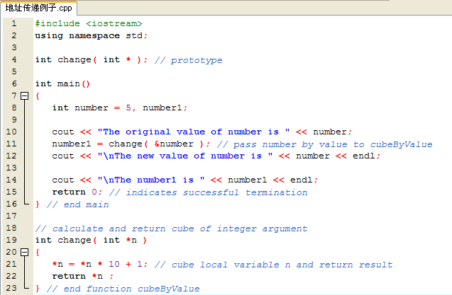
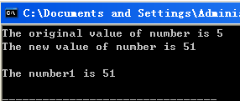

Slide 20
4 Passing Arguments to Functions by Reference with Pointers
一个函数只能返回一个值
使用引用参数向函数进行参数传递
函数可以修改参数的原始值
函数可以返回“多个值”

Slide 21
4 Passing Arguments to Functions by Reference with Pointers
使用指针参数按引用传递
使用 & 运算符传递参数地址
如果实参是数组，因为数组名即为数组首地址，故数组名前无须再加“&”
* 运算符在函数内部用做参数的别名来使用

Slide 22
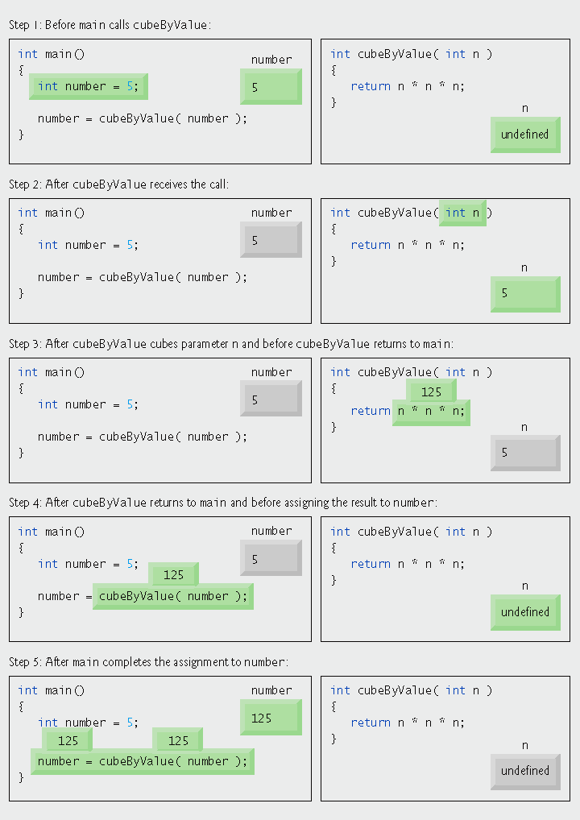
Pass-by-value analysis of the program

Slide 23
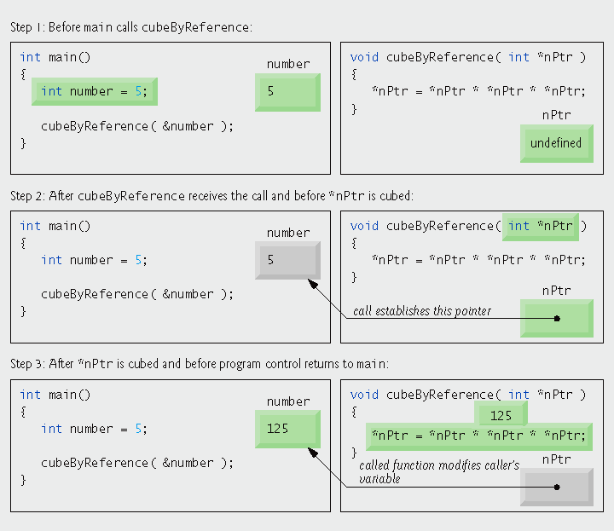
Pass-by-reference analysis (with a pointer argument) of the program

Slide 24
5 Using const with Pointers
Principle of least privilege (最低权限原则)
只需授予函数完成任务所需要的权限即可
例如：打印数组元素的函数
数组元素应为 const，不需要修改的权限
数组长度应为 const，不需要修改的权限

Slide 25
5 Using const with Pointers
const pointers(写在哪个前面就是修饰哪个)
Constant pointer to a non-constant int
int *const myPtr = &x;
Non-constant pointer to a constant int
const int *myPtr = &x;
Constant pointer to a constant int
const int *const Ptr = &x;

Slide 26
1. 非 const int , 非 const pointer
x=5 ; // 合法修改
*xptr = 20 ; // 合法修改
xptr = &y ; // 合法修改

Slide 27
2. const int , 非 const pointer
x=15 ; // 非法修改
*xptr = 20 ; // 非法修改
xptr = &y ; // 合法修改

Slide 28
3. 非const int , const pointer
x=5 ; // 合法修改
*xptr = 20 ; // 合法修改
xptr = &y ; // 非法修改

Slide 29
4. const int , const pointer
x=5 ; // 非法修改
*xptr = 20 ; // 非法修改
xptr = &y ; // 非法修改

Slide 30
非constant 数据，
非 constant 指针
convertToUppercase modifies variable phrase
情况1：非静态指针传送非静态参数。

Slide 31
Parameter sPtr is a nonconstant pointer to nonconstant data
Function islower returns true if the character is lowercase
Function toupper returns corresponding uppercase character if original character is lowercase; otherwise toupper returns the original character
Modify the memory address stored in sPtr to point to the next element of the array

Slide 32
constant 数据，
非 constant 指针
Pass pointer phrase to function printCharacters
sPtr is a nonconstant pointer to constant data; it cannot modify the character to which it points
Increment sPtr to point to the next character
情况2：非静态指针传送静态参数。

Slide 33
Parameter is a nonconstant pointer to constant data
Pass the address of int variable y to attempt an illegal modification

Slide 34
Attempt to modify a const object pointed to by xPtr
Error produced when attempting to compile
静态参数在被调函数内被修改----非法。

Slide 35
非constant 数据，
constant 指针
可以通过指针修改非const数据
但不能修改const指针的取值。即不能指向另一个变量
Line 14 generates a compiler error by attempting to assign a new address to a constant pointer

Slide 36
constant 数据，
constant 指针
不能修改 const 数据
不能修改 const 指针，即不能指向另一个变量

Slide 37
Outline
Line 18 generates a compiler error by attempting to modify a constant object
Line 19 generates a compiler error by attempting to assign a new address to a constant pointer

Slide 38
6 Selection Sort Using Pass-by-Reference
Implement selectionSort using pointers
Selection sort algorithm
Swap smallest element with the first element
Swap second-smallest element with the second element
Etc.
Want function swap to access array elements
Individual array elements: scalars
Passed by value by default
Pass by reference via pointers using address operator &

Slide 40
Declare array as int *array (rather than int array[]) to indicate function selectionSort receives single-subscripted array
Receives the size of the array as an argument; declared const to ensure that size is not modified
通过前面的例子可知：如果不是以地址作参数，调用函数后得不到交换后的两数

Slide 41
Arguments are assed by reference, allowing the function to swap values at the original memory locations

Slide 42
6 Selection Sort Using Pass-by-Reference
良好编程习惯：当要传送一个数组给另一个函数时，一般也将数组大小一起传送。这样可以增加函数的可重用性。

Slide 43
7 sizeof Operators
sizeof operator
返回操作数所占的字节数
For arrays, sizeof returns
( size of 1 element ) * ( number of elements )
If sizeof( int ) returns 4 then int myArray[ 10 ]; cout << sizeof( myArray ); will print 40
Can be used with
Variable names
Type names
Constant values

Slide 44
Operator sizeof applied to an array returns total number of bytes in the array
返回存放address数组的首地址所需字节数
返回该指针所占的字节数

Slide 45
7 sizeof Operators (Cont.)
sizeof operator (Cont.)
在编译阶段完成
Eg. double realArray[ 22 ];
Use sizeof realArray / sizeof( double ) to calculate the number of elements in realArray
Parentheses(括号) are only required if the operand is a type name

Slide 47
Outline
Operator sizeof can be used on a variable name
Operator sizeof can be used on a type name
Operator sizeof returns the total number of bytes in the array

Slide 48
7 sizeof Operators (Cont.)
良好编程习惯：数据类型具体需要多大空间进行存储一般会因系统不同而不同，如果采用 sizeof 的方法进行获取可使程序具有更大的可重用性。
错误预防技巧：sizeof运算是在编译阶段进行，而不是在程序运行阶段进行，因此，sizeof的合理使用并不会降低系统的性能。

Slide 49
8 Pointer Expressions and Pointer Arithmetic
Pointer assignment
同一类型之间的指针可以相互赋值
如果为不同类型，需要使用类型转换运算符
例外：void *（代表任何类型）
无须将指针转换为void *
需要将void *转换为其他类型
void 指针不能被 dereferenced(绝对不能企图使用该指针所指向的内存中所存储的内容 )

Slide 50
9 Relationship Between Pointers and Arrays
数组与指针密切相关
数组名为 constant 指针，表示数组所占内存地址不能改变
指针可以用来进行数组的索引操作

Slide 51
9 Relationship Between Pointers and Arrays
使用指针访问数组元素
int b[ 5 ]; int *bPtr; bPtr = b;
b[ n ] = *( bPtr + n )
&b[ 3 ] = bPtr + 3（向后跳3个元素，不能理解为3字节）
b[ 3 ] = *( b + 3 )
b[ 3 ] = bPtr[ 3 ]

Slide 52
9 Relationship Between Pointers and Arrays
常见编程错误：尽管数组名是指向数组开头的指针，并且指针可在算术表达式中修改，但是数组名不可以在算术表达式中修改，因为数组名实际上是个常量指针，永远指向数据的第一个元素。

Slide 53
Using array subscript notation
Using array name and pointer/offset notation

Slide 54
Using pointer subscript notation
Using pointer name and pointer/offset notation

Slide 57
Outline
通过数组下标符号将string s2 复制到 s1
通过指针符号将s2复制到s1
Increment both pointers to point to next elements in corresponding arrays
我们能够写出这样精巧的小程序吗？

Slide 58
10 Arrays of Pointers
数组中可包含指针
通常用来存储字符串数组
例如：
const char *suit[ 4 ] = { "Hearts", "Diamonds", "Clubs", "Spades" };
suit 数组元素具有固定长度(每个字符串的首地址)，但其指向的字符串可以为任意长度
数组存放的是字符串首地址，而不是字符串本身

Slide 59
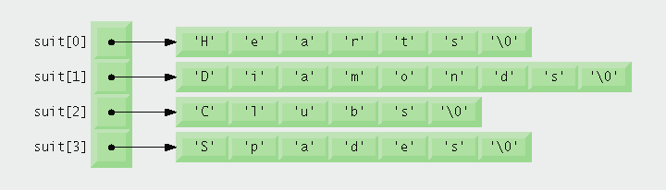
10 Arrays of Pointers

Slide 60
11 Function Pointers
函数指针
包含函数的地址
函数名为函数的起始地址

Slide 61
Outline
Parameter is pointer to function that receives two integer parameters and returns bool result
一个指向函数的指针，该函数有两个输入参数，返回值是bool型

Slide 62
Outline
Pass pointers to functions ascending and descending as parameters to function selectionSort

Slide 63
Outline
compare 是一个指向函数的指针，该函数返回一个 bool 值
必须用括号括起来，表示是函数的指针
Dereference pointer compare to execute the function

Slide 64
Outline

Slide 65
11 Function Pointers (Cont.)
函数指针数组
指：一个数组，其元素是一组地址，每个地址指向一个函数
函数名与数组名类似，表示该函数在内存中的首地址
常用于一些菜单驱动的应用程序中

Slide 66
Array initialized with names of three functions

Slide 67
Outline
Call chosen function by dereferencing corresponding element in array

Slide 68
Outline

Slide 69
12 String Manipulation Functions
<cstring>
操纵字符串数据
比较字符串
字符和字符串查找
字符串分隔

Slide 70
(1) 字符和基于指针的字符串
Character constant
Integer value represented as character in single quotes
Example
'z' is integer value of z
122 in ASCII
'\n' is integer value of newline
10 in ASCII

Slide 71
String
Series of characters treated as single unit
Can include letters, digits, special characters +, -, *, ...
String literal (string constants)
Enclosed in double quotes, for example:
"I like C++“
Have static storage class
Array of characters, ends with null character '\0'
String is constant pointer
Pointer to string’s first character
Like arrays

Slide 72
String assignment
Character array
char color[] = "blue";
Creates 5 element char array color
Last element is '\0'
Alternative for character array
char color[] = { 'b', 'l', 'u', 'e', '\0' };
Variable of type char *
char *colorPtr = "blue";
Creates pointer colorPtr to letter b in string "blue"
"blue" somewhere in memory

Slide 73
常见编程错误：如果不分配足够的内存空间来保存最后的表示结束的空字符，会引起错误。
常见编程错误：如果用数组来保存字符串，要保证数组足够的大从而可以存放最大的字符串，否则，被没有保存完全的内容会被保存到数组后面的内存中，从而引起逻辑错误。

Slide 74
Reading strings
Assign input to character array word[ 20 ]
cin >> word;
Reads characters until whitespace or EOF
String could exceed array size
cin >> setw( 20 ) >> word;
Reads only up to 19 characters (space reserved for '\0')

Slide 75
cin.getline
Read line of text
cin.getline( array, size, delimiter );
Copies input into specified array until either
One less than size is reached
delimiter character is input
Example
char sentence[ 80 ]; cin.getline( sentence, 80, '\n' );

Slide 76
常见编程错误：如果将一个字符采用 char *string的格式表示，会引起“a fatal runtime”错误。因为char *string表示一个指针，可能代表一个很大的整数，而字符只用很小的整数来表达(ASCII 0~255)，两者之间的差异可能引起操作系统的错误。
常见编程错误：如果将字符串作为参数传送给一个只需要一个字符作为参数的函数时，会引起编译错误。

Slide 77
(2) 字符串处理库中的字符串操作函数
String handling library <cstring> provides functions to
Manipulate string data
Compare strings
Search strings for characters and other strings
Tokenize strings (separate strings into logical pieces)
Data type size_t
Defined to be an unsigned integral type
Such as unsigned int or unsigned long
In header file <cstring>

Slide 78
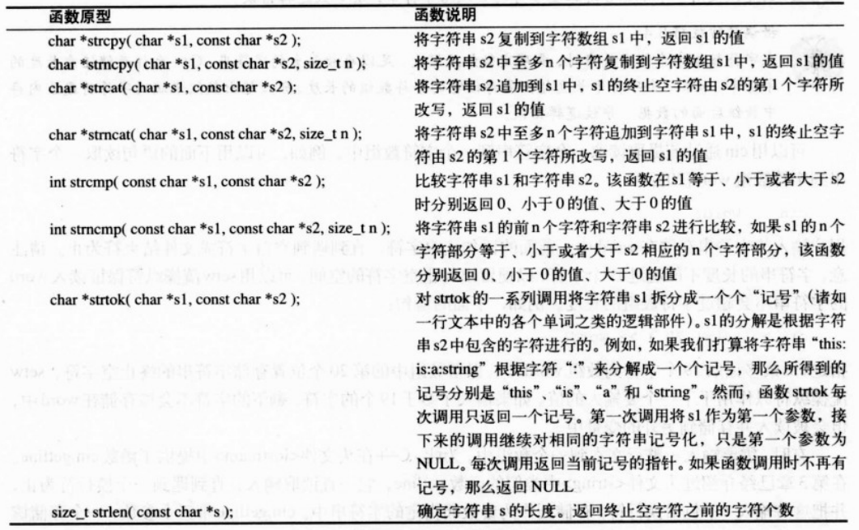

Slide 79
常见编程错误：如果没有将头文件<cstring>包含在文件中，采用上面的函数完成相应功能时将出现编译错误。

Slide 80
复制字符串
char *strcpy( char *s1, const char *s2 )
Copies second argument into first argument
First argument must be large enough to store string and terminating null character
char *strncpy( char *s1, const char *s2, size_t n )
Specifies number of characters to be copied from second argument into first argument
Does not necessarily copy terminating null character

Slide 81
Outline
<cstring> contains prototypes for strcpy and strncpy
Copy entire string in array x into array y

Slide 82
Outline
Copy first 14 characters of array x into array z. Note that this does not write terminating null character
Append terminating null character
String to copy
Copied string using strcpy
Copied first 14 characters using strncpy

Slide 83
连接字符串
char *strcat( char *s1, const char *s2 )
Appends second argument to first argument
First character of second argument replaces null character terminating first argument
You must ensure first argument large enough to store concatenated result and null character
char *strncat( char *s1, const char *s2, size_t n )
Appends specified number of characters from second argument to first argument
Appends terminating null character to result

Slide 84
<cstring> contains prototypes for strcat and strncat
Append s2 to s1
Append first 6 characters of s1 to s3

Slide 85
Outline
Append s1 to s3

Slide 86
比较字符串
int strcmp( const char *s1, const char *s2 )
Compares character by character
Returns
Zero if strings are equal
Negative value if first string is less than second string
Positive value if first string is greater than second string
int strncmp( const char *s1,
const char *s2, size_t n )
Compares up to specified number of characters
Stops if it reaches null character in one of arguments

Slide 87
Outline
<cstring> contains prototypes for strcmp and strncmp
Compare s1 and s2
Compare s1 and s3
Compare s3 and s1
Compare up to 6 characters of s1 and s3
Compare up to 7 characters of s1 and s3
Compare up to 7 characters of s3 and s1

Slide 88
Outline

Slide 89
Tokenizing
Breaking strings into tokens
Tokens usually logical units, such as words (separated by spaces)
Separated by delimiting characters
Example
"This is my string" has 4 word tokens (separated by spaces)

Slide 90
Tokenizing (Cont.)
char *strtok( char *s1, const char *s2 )
Multiple calls required
First call contains two arguments, string to be tokenized and string containing delimiting characters
Finds next delimiting character and replaces with null character
Subsequent calls continue tokenizing
Call with first argument NULL
Stores pointer to remaining string in a static variable
Returns pointer to current token

Slide 91
<cstring> contains prototype for strtok
First call to strtok begins tokenization
Subsequent calls to strtok with NULL as first argument to indicate continuation

Slide 93
Determining string lengths
size_t strlen( const char *s )
Returns number of characters in string
Terminating null character is not included in length
This length is also the index of the terminating null character

Slide 94
<cstring> contains prototype for strlen
Using strlen to determine length of strings

Slide 95
思考题：下面程序的运行结果？为什么？
char *GetMemory(void)
{
char p[] = "hello world";
return p;
}
int main()
{
char *str = NULL;
str = GetMemory();
cout << str << endl;
return 0;
}

Slide 96
思考题：下面程序的运行结果？为什么？
int main()
{
char *str = (char *) malloc(100);
strcpy(str, "hello");
free(str);
if(str != NULL)
{
strcpy(str, "world");
cout << str << endl;
}
return 0;
}

Slide 97
Thank you!

